Slide 1
Challenges Faced by “Gifted Learners”
Marked Tree Public Schools
G.T. Coordinator

Slide 2

Disadvantage
Gifted learners, although possessing higher levels of intelligence, are disadvantaged in the sense that they frequently do not, or are not given opportunities, to reach their full potential. (Farmer, 1993)
Gifted learners are labeled as “gifted,” “talented,” “underachievers,” “educationally disadvantaged” or “special needs.”
Why? According to studies, schools are unaware how to appropriately cater to their needs (diezmann& Watters, 2001: Langrehr, 2006).

Slide 3

Traditionally Identified
Typically, students are identified based on their I.Q. score. The learner is typically one with a higher-than-average IQ score.
Top 2-7% of standardized IQ score.
Approximately 130+ of IQ composite score (although, “cut-off” scores are not permitted during identification)
Studies suggest to assess the “creative-critical thinking” and using IQ for placement is the first way the group may be disadvantaged.

Slide 4

Failure to Meet Needs of Gifted
Gifted children have special learning needs, which if not met, can lead to:
          frustration
          a loss of self-esteem
          boredom
          laziness
          underachievement
          disinterested in learning
Failure to meet the needs of the gifted learner early, may create serious learning difficulties when faced with complex material in higher studies.

Slide 5
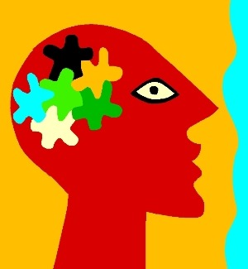
Two Mindsets
The failure to identify exactly what is gifted has created a problem for the G.T. programs.
Within our nation, there is no exact definition for giftedness. Some states have certain IQ scores, while others require a much broader look at diverse criteria. In addition, there are two mindsets of giftedness:
1st area- High Intelligence
2nd- Creative Intelligence
“Giftedness” is primarily highlighted as one with a high I.Q., however data shows that the creative mind and critical mind need to be treated as equally gifted. (Langrehr-2006)

Slide 6
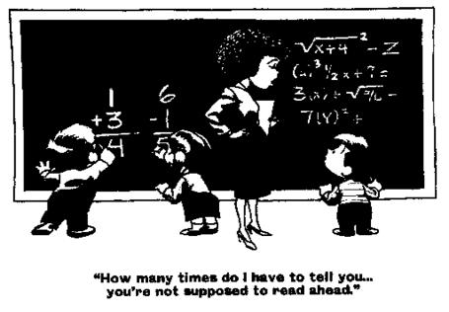
Big fish, Little Pond
Another challenge for gifted students include trying to “fit in.” Problems that may emerge include:
. Socio-emotional problems
. Isolation from peers
. Pressure to conform- achieve at peers level
. Resistance toward authority
. Refusal to complete routine and repetitious work
. Frustration with everyday life – “unnecessary practice”
of skills already mastered.
. Sensitivity to higher expectations
. Displacement or dissonance
. Depression
. Perfectionism

Slide 7

Core Issue
Gifted students are different from their peers and should be treated and taught using separate, often accelerated, methodology and pedagogy.
Suggestions to accommodate the challenges of the gifted:
. Develop a secure relationship with gifted student.
. Make provisions with appropriate academic challenges.
. Demonstrate respect and support of the gifted program.
. Allow for advanced intellectual studies.
. Recognize capabilities and adjust according to needs/abilities.
. Explore social interaction with both age and intellectual peers.
. Coordinate efforts of the school with the family and supplemental programs.

Slide 8
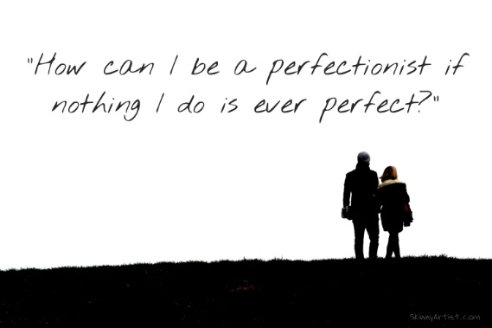
Combat Tendency for Perfectionism
The tendency for gifted students to display the tendency for perfectionism can be combated through teaching study skills and academic planning.
. Make provisions within the G.T. program
. Recognize that G.T. students do not always keep a 4.0 GPA.
. Support the student and do not point out grades that are “less than perfect.”
. Guide student to take proper courses throughout educational career.
. Allow students flexibility in the learning process.
. Provide a “sense of direction.”
. Recognize students that lack confidence, socially or academically, and provide much needed support.
. Encourage G.T. students when behavior exhibits uncertainty.

Slide 9
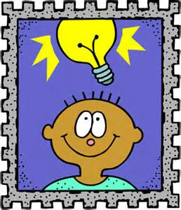
Combat the Challenges
Identify – Recognize gifted characteristics and refer students that exhibit traits associated with giftedness.
Educate – Seek knowledge within the field of gifted education. Read correspondence offered by the program/ Attend in-service/ Provide differentiation when applicable.
Support- Provide support academically and affectively for the student. Demonstrate support for the program and respect for students.
Opportunities- Share opportunities and resources that may be beneficial to the student.
Give “equal opportunities” and recognize the other end of the spectrum.

Slide 10
References
Crocker, T. (2004) “underachievement: is our vision too narrowed and blinkered? 131: 10-14.
Diezmann, C.M. Watters, J.J. (2006) “Balancing Opportunities for Learning and Practicing for Gifted Students” in Curriculum Matters 5(1):3-5.
Farmer, D. (Ed.) Gifted Children Need Help? A guide for parents and teachers. Strathfield: NSW Association for Gifted and Talented Children (1993).
Langrehr, J. “New ways for identifying gifted thinkers.” in Gifted 140: 11-14
Yeung, A.S.: Chow, A.P.Y; Chow, P.C.W. and Liu, W.P. (2006) “Self-concept of gifted students: the reddening and blackening effects” in AARE 2005 International education research conference: Association for Research in Eduation, 27, Nov – 1 Dec. 2005.
For additional information, please contact the G.T. Coordinator.

