Slide 1
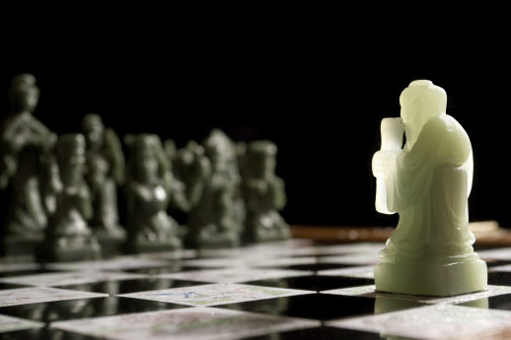
All About Chess
Marked Tree Gifted & Talented Program
Mrs. Teresa Rogers
G.T. Coordinator

Slide 2
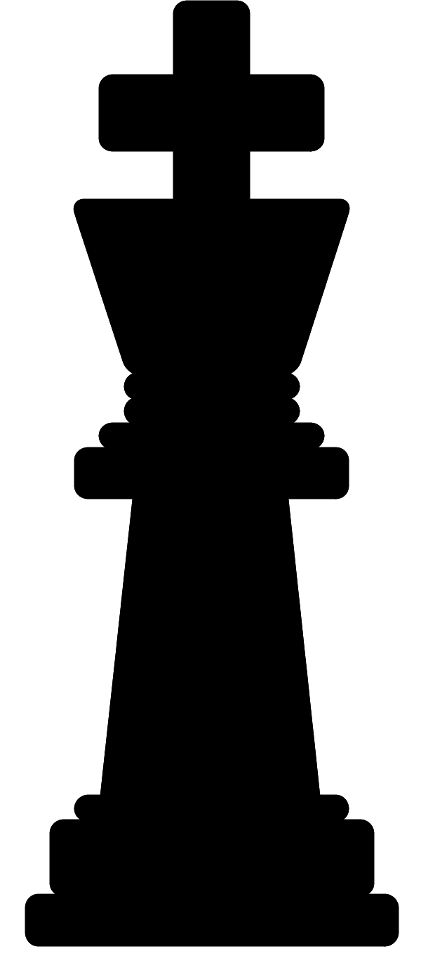
Chess Makes You Smart; Here's the Proof!
Playing chess has proven to help students:
enhance their creativity,
improve their power of concentration,
develop and expand critical thinking skills,
boost memory and retention,
achieve superior academic performance.
problem-solving capabilities,
provide cultural enrichment,
advance intellectual maturity,
enhance self-esteem.
Benjamin Franklin once said, "Chess teaches foresight, by having to plan ahead; vigilance, by having to keep watch over the whole chess board; caution, by having to restrain ourselves from making hasty moves; and finally, we learn from chess the greatest maxim in life - that even when everything seems to be going badly for us we should not lose heart, but always hoping for a change for the better, steadfastly continue searching for the solutions to our problems."
Benjamin Franklin (1706-1790)
Statesman, philosopher, inventor, scientist, musician, economist

Slide 3
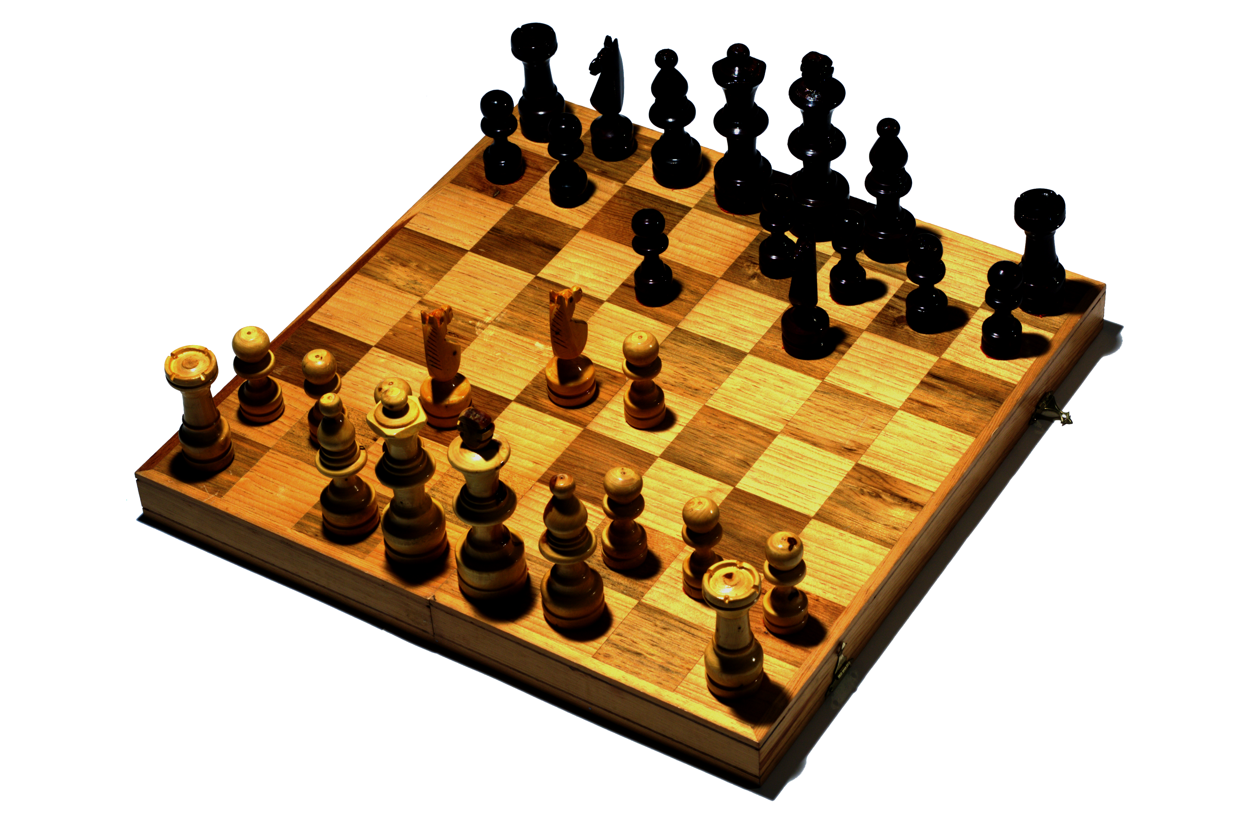
Basic Chess Information
The game of chess is over 1300 years old and is one of oldest and the
most popular games in the world.
Chess is a two-player strategy game between two armies with 16 pieces for each player.
The objective of the game is to place the opponent's King into checkmate, which means the King is trapped.
Chess is easy to learn, but can take a lifetime to master.

Slide 4
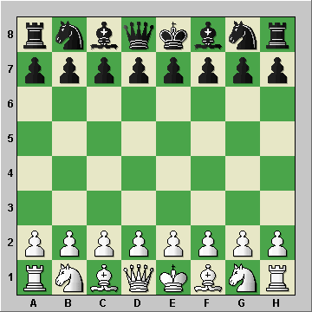
How to Set Up the Board and Pieces
Before you start to play a game of chess, you obviously have to setup the board and pieces, and they have to be setup the same way every time. Here is the correct way to set up the board and pieces for play:
The board is 8 squares by 8 squares, for a total of 64 squares. There IS a right way and a wrong way to set up the board. The rule to remember here is that a light-colored square MUST go in your right hand corner, as noted above.

Slide 5
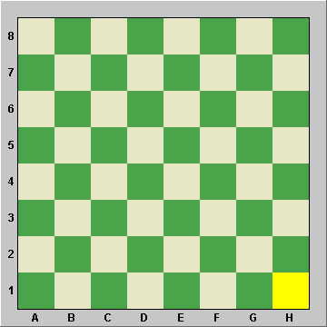
Some boards come with letters and numbers along the outside edges, as I'm showing here. That has to do with something called 'chess notation', which we'll get into later down the road. But if your board has these letters and numbers, you position it so that the letters face the players and the numbers are along the right-hand and left-hand sides.
The horizontal squares, or ranks are numbered 1 to 8.
The vertical squares, or files, are lettered from A to H.
For example, h1 is the right hand corner square marked with an “X”.
If you do that, then your right-hand corner square will be light-colored, guaranteed!
x

Slide 6
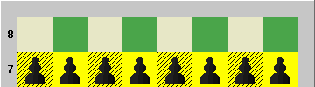
Let’s get started by setting up the pawns. There're 8 white pawns and 8 black pawns. They're simple. You just line them up on the second and seventh rows. (8 squares, 8 pawns. Simple.)

Slide 7
KING
King (K - black, k - white)
The king is the most important piece in the game of chess. This is because the
objective of the game is to capture your opponent's king.
The king has the ability to move one space in any direction.
Value= Infinity
However, the king cannot put himself in danger, which means two kings can never be side by side. If the King can be captured he is said to be “in
check”. If he cannot move to a square wherehe is not threatened, and if the checking piece cannot be captured or blocked, the King is checkmated and the game is over.

Slide 8
QUEEN
Royal piece- When setting up, make sure it matches itself to the corresponding colored squre.
Queen (Q – black, q –white)
The queen may not be the most important piece on the board, but she is the
most powerful piece.
The queen can move any number of spaces in any direction.
Value- 9 points

Slide 9
ROOK
The rook has the ability to move horizontally or vertically any number of squares in any direction.
The rook, also a powerful piece, is worth 5 pts.
The rook works best close to the king, keeping one on each end so it can “sweep” the opponents away.
(Do not call it a “castle”. . . Castle means something completely different in chess. We will discuss it later.)

Slide 10
KNIGHT
The Knight is a minor, yet vital, piece in the game of chess. The knight, unlike any other
piece on the chessboard, can 'jump over‘ pieces.
The knight moves in an 'L' shape moving either two spaces horizontally and one space
vertically, or two spaces vertically and one space horizontally. Example: 1 up and 2, over.
Get the knights out early and use them to take away opponents royal pieces!
Value- 3 points

Slide 11
BISHOP
Bishop (B – black, b – white)
The Bishop is the second minor, yet vital, piece in the game of chess.
The Bishop can move diagonally any number of squares in any direction. If they are on a light colored square, they will only travel on a light color. Same with black, if they are on a black square, they will only travel diagonally on a black square.
Watch out for bishops- sometimes they are tricky!
Value= 3 pts.

Slide 12
Pawn (P – black, p – white)
The pawn can be the difference between winning and losing a game of
chess. Pawns can only move forward one space however; from its starting position
a pawn can advance two spaces.
Pawns don't capture pieces by advancing straight into them horizontally or
vertically; instead they capture pieces by advancing diagonally into the piece. The
Pawn's special ability is that it can be exchanged for a queen, rook, knight, or
bishop when it reaches the last square on the other side of the board. Go for the
Most valuable piece!
Remember, they can never move backwards!
Value= 1 pts.

Slide 13
Set up the Board
Position of all the pieces on the board at the beginning of a “Full” game.

Slide 14
Rules to Remember
The white Queen goes on a light square (sometimes red), the Black Queen on a dark square ("Queen on her own color").
The square in the lower right hand corner is a red one, i.e. "red on right" or the white one: “light on right”.
The opposing Kings and Queens go directly opposite of each other.
White moves first, and then each player takes a turn moving.
If you take your hand off a piece your move is over, UNLESS you made an illegal move.
During each player’s turn, only one piece may be moved (except when castling).
The Knight is the only piece that can jump over other pieces.
All other pieces can only move along unblocked lines.
You may not move a piece to a square already occupied by one of your own pieces, but you can capture an enemy piece that stands on a square where one of your pieces can move. Simply remove the enemy piece from the board and put your own piece in its place.
You may not detract or annoy your opponent in any manner whatsoever.
Many beginning games end in a draw or stalemate. This happens when a King is forced to move and cannot do so without putting himself in check.

Slide 15
How to Win
When the King is attacked the player should say, “Check”. There are then three things that could happen:
1. The King moves to safety.
2. Another piece moves in to block and protect the King.
3. Another piece captures the piece that was attacking the King.
If none of these can happen the King is trapped, which is called “Checkmate”, and the game is over! The King is the ONLY piece that can never be taken off the chess board during a game.
Necessary Conditions for a Checkmate:
• Is the King in check?
o Answer must be Yes.
• Wherever the King moves, is it check?
o Answer must be Yes.
• Can any other chess piece block the check?
o Answer must be No.
• Can the King capture the checking piece?
o Answer must be No.
Necessary Conditions for a Stalemate:
• Is the King in check?
o Answer must be No.
• Can the King move to a square that it’s Not in Check?
o Answer must be No.
• Does the King’s army have another chess piece it can move?
o Answer must be No.
• Does it have to be the King’s side move?
o Answer must be Yes.

Slide 16
What is a draw?
Unlike a stalemate, a draw or tie can occur when neither side has sufficient chess material to checkmate. The players can also agree upon a draw. Also,
a repetition of moves can end in a draw. In classrooms an easy to remember rule is "Ten to Tie", thus allowing players to agree to count 10 moves before
declaring a stalemate.
Minimum Chess Pieces to Checkmate
King and Queen King and Rook
King and two Bishops King, Knight and Bishop
King and Pawn (if promoted to Queen or Rook)
Stalemates or Draws are both ties.
In tournament play, a win is one point, a draw is ! point and a loss is no point. Stalemates are very rare in high level play, but are frequent occurrences in beginning play.
If you are not quite ready for this stage then you can also add up the value of the piece captured and the army with the most value left is said to have
the advantage!
Capturing
Each chess piece has a specific movement. When a piece moves into the movement path of an enemy piece it can be captured and removed from the
chess board. However, the Knight captures only on its destination square.
Protection
When a chess piece is captured, other chess pieces may be able to capture it back. This is called protection. In this first example the White Queen
captures the Black Rook. The Black King protects the Black Rook. This means the King can capture the Queen.

Slide 17
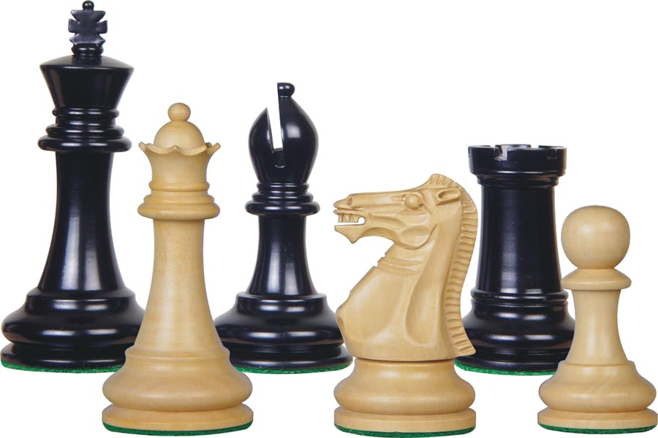
Strategies
Before you move your queen, rooks, or king, move your knights and bishops toward the center of the board. Do not leave them behind the pawns.
Control the center of the board, this will allow you to attack more squares.
Move your Knights, Bishops, Rooks and Queen – normally in that order. Try to reinforce your developed pieces by placing them where they can be protected by your other pieces or pawns.
Quickly advance your pawns so they control squares on the opponent’s half of the board.
Watch your back and your front! Always think to yourself what was my opponent’s last move? What is he up to? Is he setting a trap to capture? Then decide your own plan. Always look at all your possibilities and ask, “Does my move leave something unprotected?”
Each turn check out the safety of your King and check out whether your opponent’s King is exposed.
The successful attack simply outnumbers the “available” defenders, with the final point count in the attacker’s favor. Note that although an exchange may be equal, the use of certain “available” defenders may result in one side building a later successful attack because of the resulting position. Look for positions that will allow Forks or take advantage of Pins.
Castle early! Casling is a move that allows you to move your king to safety and bring your rook into play. Once all the squares between your rook and the king are unoccupied, you can “castle” by moving your king two squares toward the rook and move your rook to the other side of the king. If your opponent neglects to castle, you might be able to launch an attack on his king. This is the ONLY time in which more than one piece may be moved in a turn.
Lose pieces wisely- Know the value of the pieces and swap pieces only if it to your advantage.
Queen-9 pts. Rook- 5 pts. Bishop and Knight- 3 pts. Pawn- 1 pt.

Slide 18
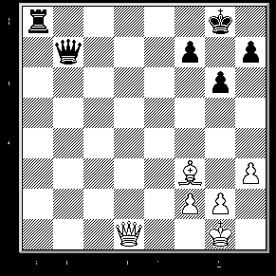
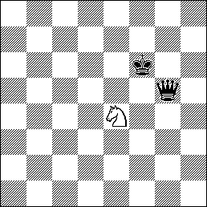
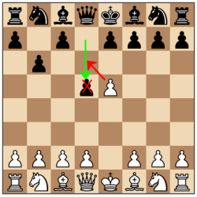
These three stages need different strategical approach in order for you to win your game.
The opening game is where you plan and placed your chess pieces strategically to form a position that will have the greatest advantages in the middle game.
The middle game is where you will battle and perform attacks on your opponent’s pieces to be able to capture them and of course defense, for the safety of your King because the game will end if one of your King was captured and the player whose King is captured lose the game.
The end game is where the game is concluded. As said earlier, when one King is captured, the capturer wins the game.
Questions. . .
What do you mean by “pin?” Pinning your opponent’s pieces means that you have immobilized them. This is a great strategy! Immobilizing them to not make an attack is very beneficial to you. A chess piece is pinned if it cannot move or stuck with the reason of a more valuable piece may be attack if you move it. For instance, Bishops are often pinned by Knights in the opening. The pin is alleviate by the movement of a valuable piece which is the King or my positioning another piece.
What is a “skewer?” A skewer is similar to a pin except in this case the piece of greater value (for example, the King, Queen or Rook) is in front. An enemy piece attacks the piece and when this piece moves away, it leaves a piece of lesser value exposed to capture (see picture to the right).
What does the term “fork” mean in chess? A fork occurs when a piece attacks two or more pieces at the same time. Let's look at the following diagram:
What is “en passant (pronounced "aw pawsawnt")? It can only occur when a player exercises his option to move his pawn two squares on its initial movement and that move places his pawn next to the opponent's pawn. When this happens, the opposing player has the option to use his pawn to take the moved pawn "en passant" or "in passing" as if the pawn had only moved one square. This option, though, only stays open for one move.

Slide 19
Learn quick check moves . . .
If you learn moves that are typically used to get one into check, you will be ready for your opponent OR you can use them against your opponent!
One successful strategy involves four moves into check:
Pawn two spaces in front of king to D5.
Queen to A4.
Bishop to F5.
Queen to C2.
CHECKMATE
MEMORIZE THIS BEFORE THE TOURNAMENT!

Slide 20
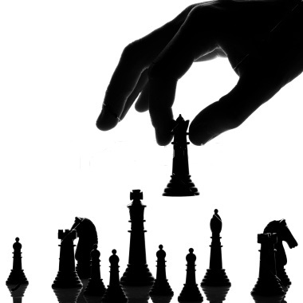
TOURNAMENT PLAY
Shake your opponents hands
Do not talk or make distracting noises.
If you are unsure- look at your notes.
Raise your hand when you are unsure of a move to ask the director.
White side will start the game.
Record the win or loss on your score sheet.
Reset the board for the next player- never leave it unset.
Good Luck!

Slide 21
Resources
https://www.chesskid.com/?m=chesskids

