Slide 1
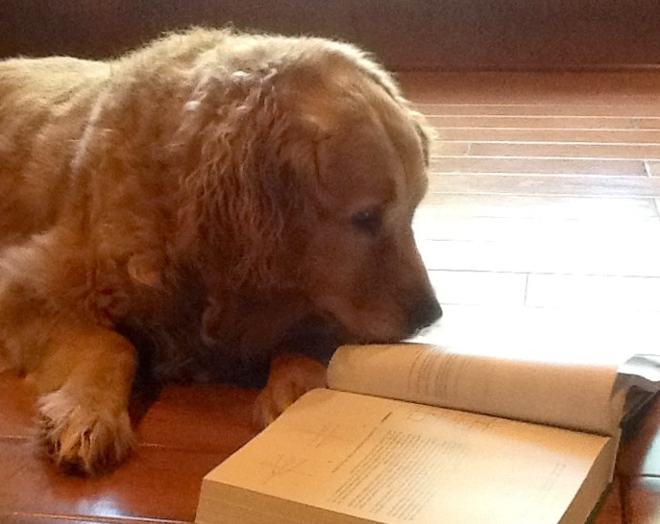
Teaching Gifted Students in the Regular Classroom
PRESENTED BY:
Marked tree Pubic School
G.T. COORDINATOR

Slide 2
Identification of Non-traditional Gifted Students
Students “At-Risk”
-Underachievement
  -Low motivation
  -Poor study skills
  -Behavioral/ social skills difficulties
Learning Disabled
-Special Education

Slide 3
A Few Facts about Regular Classrooms
and Gifted
1. Meeting their needs often exceeds the challenge of integrating disabled students.
2. Gifted students can be delightful but can also be demanding, impatient, perfectionist, sarcastic, and disruptive.
3.Few regular education teachers have received sufficient training in issues related to gifted education.
4.The IDEA is founded on the belief that all students have the right to instruction appropriate to their needs.

Slide 4
How do gifted students
differ from their classmates?
1. The pace in which they learn;
2. The depth of their understanding;
3. The interests they hold.

Slide 5
What program options do they have?
Enrichment – Whole Class
Send out Enrichment- Resource Class
Pre-AP Courses
Advance Placement
Honors
Concurrent enrollment /College
Extracurricular activities

Slide 6
What is the Role of the
Regular Classroom Teacher?
The teacher must view themselves as facilitators of learning.
As facilitators, the teacher presents the conditions for learning, then guides the student to learn, understand and interpret information.

Slide 7
Regular Classroom Teachers
Should Be Able to…..
1.Identify gifted students in their classroom.
2.Utilize methods for differentiating instruction.
3.Facilitate cooperation with parents and other teachers.
4.Become effective team members in meeting the needs of
the gifted.
5. Monitor and modify as needed.
6. Utilize resources to extend class lessons and activities.

Slide 8
Teacher Self Quiz
This brief quiz will help you assess current provisions for gifted students in your classroom.
1. Can I define a gifted child and list at least 6 behavioral traits of a gifted child?
2. What plan do I have for assessing individual strengths, weaknesses and modes of learning for all children in my room?
3. How do I accommodate the varying levels of ability in my classroom?
4. Can I list several means of differentiating curriculum activities for bright and gifted students?
5. Can I briefly describe a method I use for involving the bright and able students in planning and evaluating his/her learning activities?
6. Can I list several ways gifted students are exposed to learning opportunities and experiences beyond my class?

Slide 9
The major challenge for teachers is to create a learning environment in which gifted and talented students can fully develop their abilities and interests, without losing their sense of membership as part of the class.

Slide 10
Ways to create a learning environment suitable for all level learning…
1. Learning Styles
  a. kinesthetic
  b. visual
  c. Aural
2. Student Interest Surveys

Slide 11
Developing Differentiated Learning Experiences…
Adapting the curriculum to meet the needs of the learner
Take into consideration…
  Level of maturity
  Prior experiences
  Interests, abilities and behavioral traits
  Preferred learning styles
  Level of skills development

Slide 12
Adapting the Learning Environment for Gifted Students
Encourage divergent thinking,
Simulation and role playing,
Open-ended questions to foster critical thinking,
Independent study of special interest topics .

Slide 13
General Strategies for Modifying
Curriculum for Gifted
Lesson modifications
a. Open ended questions
b. Bloom’s Taxonomy
2. Assignment modifications
a. Give pre-test
b. Compact lessons
c. Modify assignments-
d. Independent projects
3. Scheduling Modifications
a. Cooperative learning
b. Cluster learning

Slide 14
Curriculum Compacting:
Step 1. Determine the need to do so
Step 2. Create a written plan outlining which, if any regular assignments will be completed and what alternate activities will be accomplished.
It is wise to set up a time frame for the student. Accountability is a must!

Slide 15
Summary
Regular education teachers must demonstrate respect for the gifted learners. It is advised to become knowledgeable of their needs and seek ways to meet their needs. Documentation and accountability are important to prove that the educator is working to meet the needs of the gifted.

