Slide 1
What Teachers Can Do
To Turn Around
Underachieving Gifted Students
Marked Tree G.T. Program

Slide 2
Definition of Underachievement
“…a discrepancy between potential (innate ability; gifts) and performance (achievement)” (Heacox & Cash, 2014).
Must NOT be the result of a diagnosed learning disability and must persist over a period of one school year.

Slide 3
Sobering Statistics
50% of high-ability students do not achieve well (Schultz, 2005).
Between 18-25% of high school dropouts are identified as gifted (Center for Comprehensive
School Reform and Improvement, 2008)
Concerning gifted students and college (Peterson, 2000)
 | Attend College | Finish in 4 Years
Gifted Achievers | 100% | 83%
Gifted Underachievers | 87% | 53%

Slide 4
Sobering Statistics (cont.)
Thirteen years after high school, the educational and occupational status of high school underachievers paralleled their grades in high school, rather than their abilities.
(HIGH SCHOOL DOESN’T IDENTIFY US!)
        (McCall, Evahn, & Kratzer, 1992)

Slide 5
To Be or Not To Be
Who comes to your mind after you hear each of the following descriptions:
  Lacks self-confidence as a learner
  Teacher-pleaser
  Gifted learner
  Fails homework, but passes tests
  Completes schoolwork with little effort
  Bored
  Lazy but capable
  Needs to be more challenged in school
  Doesn’t persevere when the learning task is difficult
  Doesn’t seem to have any goals
  Displays feelings of inferiority
  Loves to learn almost anything

Slide 6
Two Types of Underachievers
(both equally frustrating)
Non-producers
  Fail to do daily work yet still pass tests and perform well on standardized tests.
  Probably knew material already or learned it more quickly than other students.
Selective producers
  Not motivated by grades, these underachievers will engage in learning only when it is interesting to them.
  Know they are smart and capable of high performance.
  Heacox & Cash (2014)

Slide 7
Manifestations of Gifted Underachievers
  Disruptive, delinquent, hostile, touchy, temperamental, frustrated
  Anxious, perfectionistic, worries about failure
  Procrastinates, easily distracted, seems
  unconcerned about work
        Reis & McCoach (2000)
Now, who is coming to your mind?

Slide 8
Characteristics of Gifted Underachievers
High academic self-perception, but underachievement determines
  the types of activities,
  the amount of challenge, and
  the level of persistence
Usually has negative attitudes toward teachers, classes, and school in general
Motivation and self-regulation (thoughts, feelings, and actions related to attaining goals) is negatively affected
Goal valuation (degree to which task is important, interesting, and attainable) is also a factor
(Heacox & Cash, 2014)

Slide 9
The LARGEST DIFFERENCE between achievers and underachievers is in MOTIVATION and SELF-REGULATION (ex. disengage or make haphazard, shallow attempts at work ) and in GOAL VALUATION (ex. have to value the work or the outcome).
(Heacox & Cash, 2014)

Slide 10
Cycles of Success and Failure
Achievers are in a success cycle.
  Belief that they deserve success →
  Positive feelings about school and learning
  Desire to achieve
  Achievement
  Belief that they deserve success
  Setbacks are temporary
Underachievers are in a cycle of failure.
  Confidence as a learner is weak →
    Belief that they do not deserve success
    Negative feelings about school and learning
    Limits desire to achieve
    Failure
    Confidence as a learner weakens
    No control over whether they succeed or fail.
Both impacted by self-fulfilling prophecy

Slide 11
Risk Factors for Gifted Underachievement
Socio-emotional Factors
  Perfectionism
  Fear of Failure/Procrastination/No Risk-taking
  Peer Influences/Conformity
  Depression/anxiety
  Social immaturity
Classroom and Curricular Factors
  One Learning Goal for All/No Differentiation
  One Learning Pace for All/No Differentiation
  One Learning Path for All/No Differentiation
  One Learning Choice for All/No ….
  One Learning Expectation for All/No….

Slide 12
Risk Factors continued
Family Factors
  Inconsistent and/or extreme parenting styles and techniques
  Instability due to any kind of abuse or neglect
  Treating gifted child as an adult at too young of an age
  Pressure to succeed
Cultural Factors
  “Achievement” is culturally defined and may conflict with school’s definition
  Values are culturally specific
  Attitude-achievement paradox may exist
  Intimidated by dominant culture
  Language may be a barrier to school achievement
  Inequity in educational opportunities

Slide 13
Suggested Causes of Gifted Underachievement
An unusual or unexpected event
Power and control issues
Conflicting or unclear messages from significant adults
Lack of an intellectually stimulating environment and support for students’ passions
Fixed mindset of intelligence
Problematic beliefs (competition, perfectionism, etc.)
Gender
Family dynamics (parenting styles, trust issues, substance abuse, health issues, conflict, etc.)
Peers

Slide 14
Reflection
Look at your students
  Who do you believe are potential gifted underachievers?
  Which students have not been identified as gifted, however should be considered? REFER THEM FOR THE PROGRAM!
Share your concerns with the Counselor & GT Coordinator

Slide 15
What Can We Do To Turn Gifted Underachievers Around?
“There are three important things to remember about education:
Motivation
motivation,
motivation.”
Terrell Bell
Former Secretary, U.S. Dept. of Education

Slide 16
Think, Pair, Share
Think of a time when you were extremely motivated to learn. It might have been in preparation for your driver’s license or the winter you learned to ski.
  Why were you motivated to learn?
  What supported you in your learning?
  What made it a successful experience?
  Try to relate your experiences to what you do every day in your classroom.

Slide 17
In Our Classroom
All students, especially underachievers, need 5 C’s:
  Control—student-centered learning and instruction emphasized
  Choice—student interests and learning preferences are part of learning experiences
  Challenge—flexible, differentiated learning experiences are provided
  Complexity—novel, authentic, abstract, open-ended experiences are provided in a variety of forms including in-depth studies, contests, & higher-level-thinking skills
  **Caring—fair, flexible, humorous, non-judgmental, respected and respectful. Don’t put more pressure on a gifted student than an average student.

Slide 18
Instructional Strategies
 | Control | Choice | Challenge | Complexity | Caring
Flexible Grouping | X | X | X | X | XX
Curriculum Compacting | X | X | X | X | XX
Tiered Assignments | X | X | X | X | XX
Independent Study | X | X | X | X | XX
Honors Classes | X |  | X | X | XX
Pre-assessment | X | X | X |  | XX
Higher-level Thinking Tasks | X | X | X | X | XX
Creative Thinking Tasks | X | X | X | X | XX
Project-based Learning | X | X | X | X | XX

Slide 19
Flexible Grouping and
Curriculum Compacting
Flexible Grouping
  Interest
  Achievement level
  Activity
  Learning preference
  Special needs
Curriculum Compacting (skill work)
  Used in conjunction with pre-assessment
  Skills already mastered are removed
  Time for independent study/projects

Slide 20
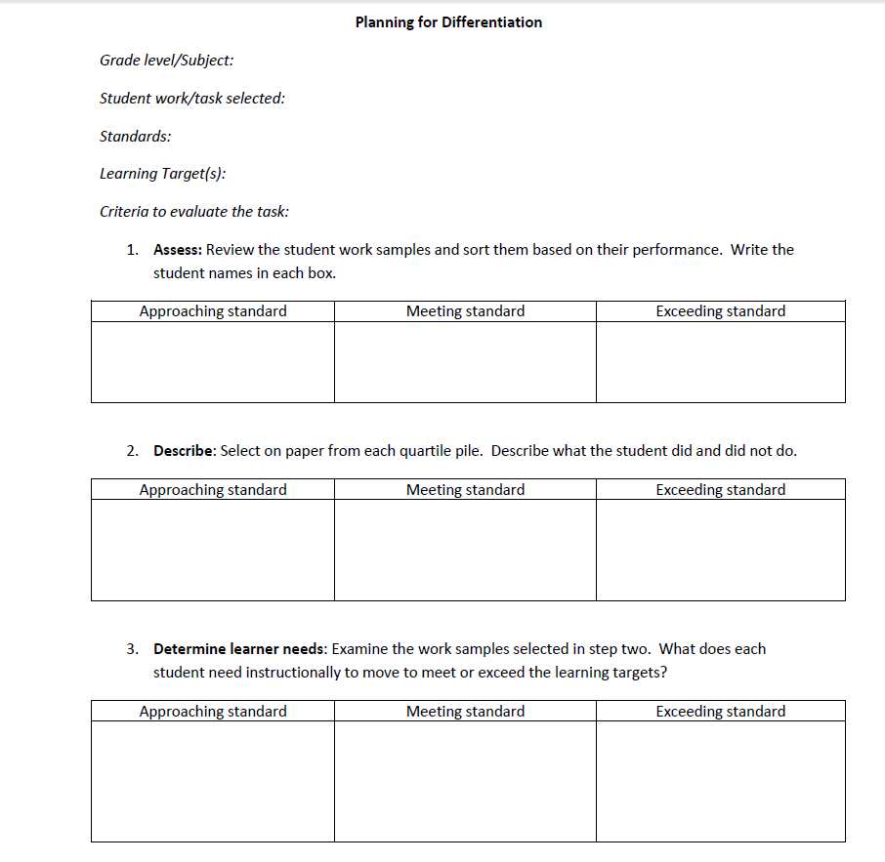
3. Tiered assignments—R. Cash
Tiered assignments are
used in lessons when all
students are focused on
the same content, essential
understandings, or key
skills, but students work
on parallel tasks that
vary based on readiness,
interests, or learning
profile.
Tier A – structured, teacher- directed
Tier B – little prompting to
organize ideas
Tier C – challenging, open-
ended, student-selected
Notes:
I retrieved this activity from the National Association of Gifted Children’s website from a presentation that was conducted at a recent NAGC Conference. I like the way that this plan takes you step by step through the process of differentiation and is fairly self-explanatory. At the top of the first page, please list the grade level and subject you will be differentiating. Then add the student work or task you have selected along with the standards and learning targets or objectives you want to accomplish. It’s also important to include the criteria to evaluate the task; in other words, list the ways you will know when your students have mastered your learning target or objective. When we know the criteria we will use to judge the success of student learning, we will be able to plan more appropriate learning tasks that will support them in meeting that criteria and reaching the learning goal.
1: Assess, the effective teacher becomes a reflective teacher. After grading a set of assignments, the teacher sorts them according to each student’s relationship to the standard(s)—approaching, meeting, or exceeding. 2. Describe, the reflective teacher selects one or two papers from each group and identifies what the student did or did not do in relation to the standard to answer the “why” and “how” questions—Why aren’t students meeting or exceeding the standard? How are students exceeding the standard? 3. Determine learner needs where the effective teacher identifies what students need instructionally in each group in order to move them to the next level. As you can see, the effective teacher is focusing on differentiating for three groups in this situation. As we have observed, differentiation is not individualizing instruction to the degree of establishing an IEP for every student. On the other hand, if only one or two students exceed the standard, you will come close to this level of individualization and should not rule it out. 4. Plan for differentiated instruction—Using your expertise in the content, in the standards, and in your students, create a plan to organize instruction to meet students’ learning needs.

Slide 21
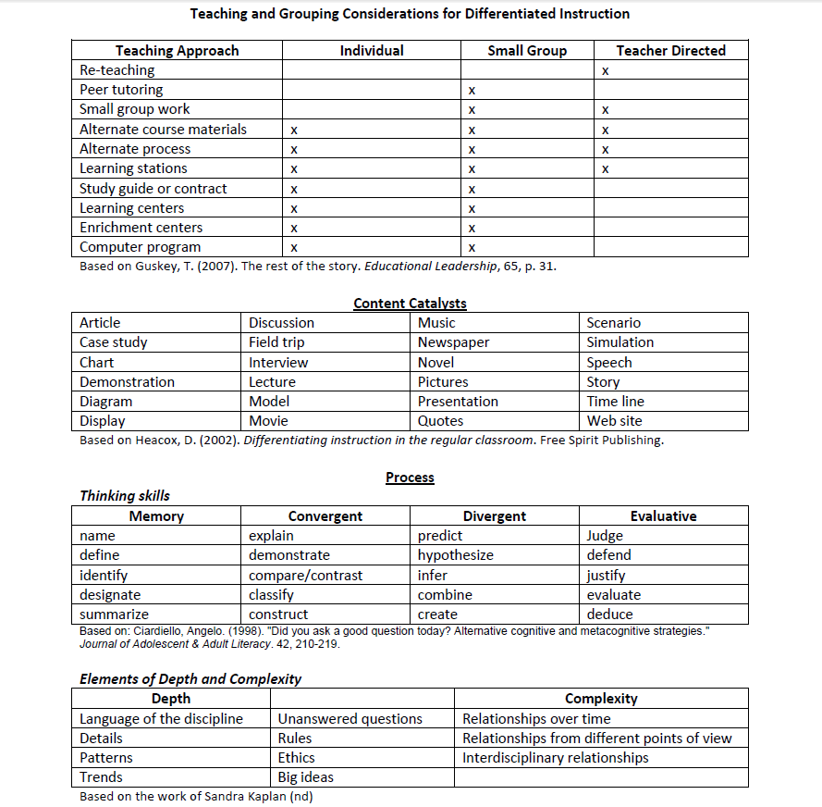
Notes:
On the second page of the “Planning for Differentiation” handout, you will find various options for differentiating instruction to meet the learning needs of the three groups of students you have identified—those approaching the standard, those meeting the standard, and those exceeding the standard. You might be asking, “Why do I need to differentiate for students who have already met or exceed standards?” and that’s a fair question. Differentiation and this planning process are based on the belief that all students deserve the opportunity to grow every day. As teachers, and especially in today’s educational climate, we are often focused on the students who struggle in our classroom, and rightly so. They need the teacher’s support to help them learn and grow and achieve. But students who are already achieving and have already mastered some or many of our learning objectives need our attention and support as well to help them learn and grow and achieve even more. In these cases, similar to special education students, the effective teacher will reach out to their gifted and talented coordinator or principal or a master teacher who has knowledge in how to meet the needs of these kinds of students. Or reach out to their local university with a gifted education program—YEAH! Regardless, I hope we can all agree that we want all our students to learn and grow and stretch every day we teach them. This is enriching for all of us and ignites our teaching! I remember telling my students, “I want to enjoy coming to work every day as your teacher, and I want you to enjoy coming to my class every day as my student.” The school years flew by and I can honestly say that I looked forward to every day in the classroom. This is my hope for you as well, and I think differentiation can help get you there if you aren’t there already. In looking over page two, we see various teaching and grouping strategies at the top, followed by content, process, and product differentiation options. Take a few moments to look over the content on this page.

Slide 22
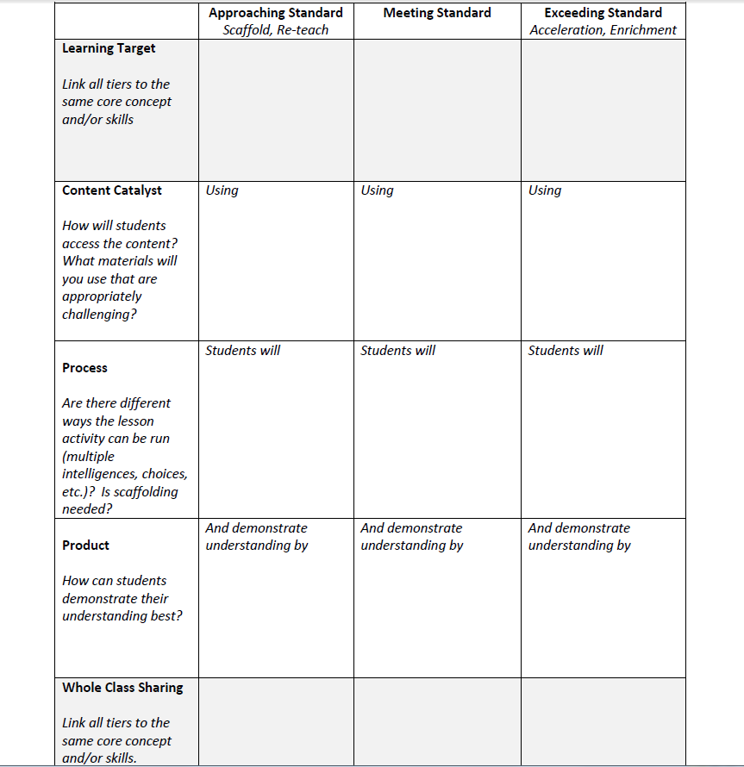
Notes:
On the third and last page of the “Planning for Differentiation” handout, you will find your workspace. Once again, we are always keeping our standard and learning target or objective in mind. Please take note of four important strategies on this page—two are listed under the top left heading “Approaching Standard” and the other two are listed under the top right heading “Exceeding Standard.” Under “Approaching Standard” we find “scaffold” and “re-teach”—two differentiated instructional strategies that will aid us in meeting the learning needs of those students who have not yet met the standard. Re-teaching is self-explanatory, but scaffolding may be new to some of you. In a nutshell, scaffolding refers to breaking the larger learning task into manageable chunks and then providing supports or tools that will help the students learn or master each chunk. When scaffolding reading, for example, you might preview the text and discuss key vocabulary, or chunk the text and read and discuss as you go. Other effective scaffolding techniques include modeling, tapping into prior knowledge, using visual aids, and allowing time for thinking after asking open-ended questions about the content. Under “Exceeding Standard” on the right, “acceleration” and “enrichment” are two effective differentiation strategies used to support high-ability students. Acceleration is one of the primary foundations in gifted education; it allows students to move through traditional schooling more rapidly, based on motivation and readiness. Acceleration may occur by grade-skipping, through curriculum compacting, or by subject area advancement, to name a few. Academic enrichment is more often used as a way to address the needs of gifted students, but the effective teacher guards against these experiences becoming activities for activities’ sake. Always keep in mind that the student should grow and stretch academically based on their participation in these enrichment experiences. As you work through this page, please use page 2 as a resource as well as your own or your colleagues’ ideas. The questions under each heading along the right-hand side of the page will help you establish your plans at each stage or step in the differentiation process. Notice that you will consider differentiation of content, process and product, and that you are continuing a sentence that spans three boxes, beginning with “content catalyst” and extending through “product.” (Point to areas of chart on screen) As you can see, your sentence or specifically, your learning objective will begin with “Using” in the “content catalyst” box, continue with “students will” in the “process” box, and conclude with “and demonstrate understanding by” in the “product” box. When you finish, you will have three differentiated objectives that meet the three groups’ (those who are approaching the standard, those meeting the standard, and those exceeding the standard) learning needs. At the bottom of the page, you will consider how you will bring all students back together again to wrap up the lesson or unit, after everyone has reached their learning targets. If you have questions or would like assistance, I will walk around the room to make myself available. I will also post my contact information for you in case you want to contact me at a later date. Remember, my goal is that you will leave here today with a differentiated lesson you can use tomorrow.

Slide 23
4. Pre-assessment
Frequent assessment guides instruction.
Formal and informal
Pre-, formative, and summative
Types of Pre-assessment
The T-W-H Chart (Think I know, Want to know, How I would like to learn about it)
Open-ended Writing (5-minute time limit)
End-of-unit or chapter assessment as pretest
Learning Preference and Interest Inventories
Five Most Difficult Questions (timed, of course)

Slide 24
Other High-impact Strategies to Personalize Education
Exploration of student interests
Pre-assessment of student content knowledge
Career exploration
Real-world experiences
Study and organizational skill instruction
Educational time spent with other capable students

Slide 25
In Our Classroom…
  Show acceptance and caring
Focus on the positive and on strengths.
Keep problems private.
Maintain contact with parents/guardians.
Keep student involved and interested; focus on process as well as the product
Provide variety and choice
Keep GT Coordinator aware of any issues with identified GT students and refer students that should be considered for the program.

Slide 26
In Our Classroom continued
Keep your expectations high and the learning rigorous.
  Provide models of work expected
  Provide descriptive feedback
  Teach student to self-assess
  Use recovery, redo, and do-over points
  Enlist student in record-keeping
  Utilize one-on-one conferences
  Assist students with organizational skills
  Set intervention techniques to assist the underachievers
Adjust your curriculum to make learning appropriate and relevant.
Create challenge, variety and opportunity for students to utilize strengths and interests to improve school performance and facilitate in-depth learning.

Slide 27
Outside of Our Classroom….
Promote extra-curricular participation
Mentoring
Counseling
  Goal: To reverse counterproductive habits and thinking.
  Focus on
    Student’s strengths
    “Making sense” of the factors involved and reframing as necessary
    Moving forward
    Empowerment—living “on purpose”

Slide 28
Outside the Classroom …
Parenting
    Establish positive communication strategies
    Set healthy family hierarchy and roles
    Demonstrate leadership within the family
    Clarify personal boundaries
    “Give permission“ to achieve
    Establish routine and organizational skills
    Communicate frequently with teacher(s) and/or counselor(s)
    Ask for help when needed

Slide 29
THERE IS HOPE!
“Children are not born underachievers. Underachievement is learned, therefore it can be unlearned.”
        (Davis and Rimm, 2004, p. 317)

Slide 30
Resources
Heacox, D. and Cash, R. (2014). Differentiation for Gifted Learners.
Hoover-Schultz, B. (2005). Gifted underachievement: Oxymoron or enigma? In Johnsen, S. & Kendrick, J. (Eds.) Teaching Strategies in Gifted Education . Waco, TX: Prufrock Press.
Long, C. (2013). Are we failing gifted students? National Education Association.
http://neatoday.org/2013/09/18/are-we-failing-gifted-students/
McCall, R.B., Evahn, C., & Kratzer, L. (1992). High School Underachievers: What Do They Achieve As Adults? Newbury Park, CA: Sage Publications.
Peterson, J.S. (2000). A Follow-Up Study of One Group of Achievers and Underachievers Four Years After High School Graduation. Roeper Review, 22(4), 217-224,
Peterson, J.S. & Colangelo, N. (1996). Gifted Achievers and Underachievers: A Comparison of Patterns Found in School Files. Journal of Counseling and Development, 74, 399-407.
Reis, S. M., & McCoach, D. B. (2000). The underachievement of gifted students: What do we know and where do we go? Gifted Child Quarterly, 44, 152-170.
The Center for Comprehensive School Reform and Improvement. (2008). Issue brief: Gifted and talented students at risk for underachievement. Washington, D.C.: Learning Point Associates and SEDL for the U.S. Department of Education.

